Slide 1
POLICE MANAGEMENT SYSTEM
PRESENTED BY
19MIS1189 – RITHIK V
19MIS1069 –MOHITH KUMAR A
19MIS1026- VENKATA SARAN P
UNDER THE GUIDINCE OF:
Dr ILAKYASELVAN

Slide 2
CONTENTS
Introduction
Objectives
Principles
Background information
Proposed method

Slide 3
INTRODUCTION
Now a days registering a police complaint against a crime is fairly difﬁcult unless you have money or power. One can face bribery issues or threats from the powerfull to not to ﬁle the case or in general normal people are afraid of the police system
POLICE MANAGEMENT SYSTEM is the system which brings general people closer to the police management to share their views and helps them reduce the risk of crime
Our aim by using this project is to develop E-cops. This system is easily accessible by all normal public, the police department and the administrative department. System is developed because the normal public is afraid to report a complaint against any crime going around them

Slide 4
By using this system, the record work is reduced and the data is stored in computer which is more conﬁdential than a paper work
The other advantages on this system is people can view the enquiry about complaints, status of complaints and other information.
POLICE MANAGEMENT SYSTEM saves a lot of the users time which they spend going to police stations and dealing with them which takes ridiculous amount of time. But by using this system the user can register a complaint online and can check the complaint status like whether the compliant got reported in FIR and the police authority can check the complaints and can ﬁle a FIR on that particular complaints

Slide 5
Since the users have to go through various phases to register a complaint like fear of police, societal pressure, police bribe, if involved in politics then political threats and personal threats to family.
By converting the existing to online the above problems won’t bother the person registering a complaint.

Slide 6
PRINCIPLES - VISIBILITY
A system with good visibility allows the user to easily translate goals into actions.
An object's function should be visible so that people can see what it is currently doing and see what buttons or controls are available. Visibility can also be made available through the use of sound or through touch with for example different textures, shapes or vibrations.
In this system there are three main buttons to be included like
Register a complaint
FIR status
Administrator login

Slide 7
Priority
The main principle is that the people should come ﬁrst .Our system mainly based and focuses on this particular principle. In this system the people are the center of the system.

Slide 8
USABILITY
Usability is one of the key concepts. It is concerned with making systems easy to learn and use. A usable system is:
easy to learn
easy to remember how to use
effective to use
safe to use
enjoyable to use

Slide 9
FUNCTIONALITIES
The functionalities of the proposed system are
User login
Registering a complaint
FIR status check
Raise an issue
Admin login
Administrator works like accepting a complaint and ﬁling an FIR through admin login
login/logout

Slide 10
PROPOSED METHOD
The main objective of this project is to make an E-cops like system which can be accessed by everyone, easy, secure and safe to use
It uses mysql as the database to store the registered complaints and for front end we use php with xampp server
Software Testing Methodology is deﬁned as strategies and testing types used to certify that the Application Under Test meets client expectations. Test Methodologies include functional and non-functional testing to validate the system.

Slide 11
STATE TRANSITIONS DIAGRAM

Slide 12
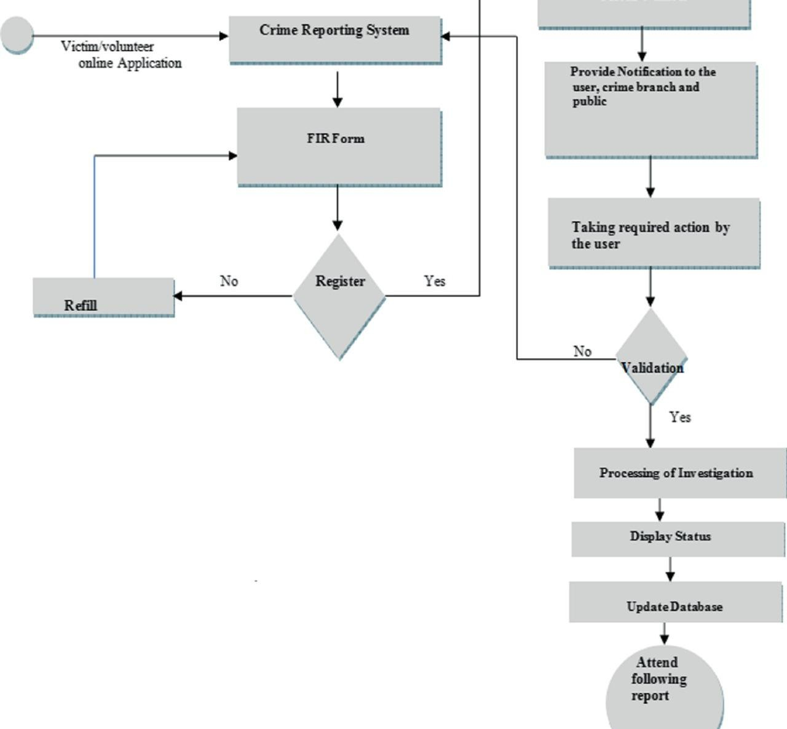

Slide 13
HIERARCHICAL TASK ANALYSIS (HTA)

Slide 14
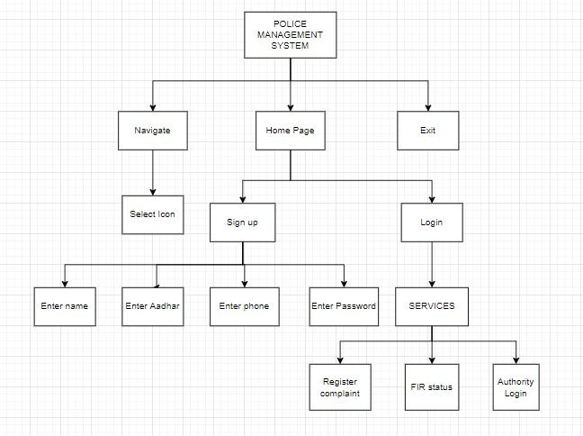

Slide 15
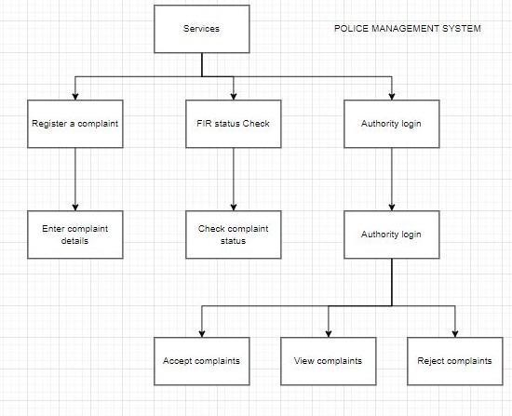

Slide 16
WIREFRAME DIAGRAM

Slide 17
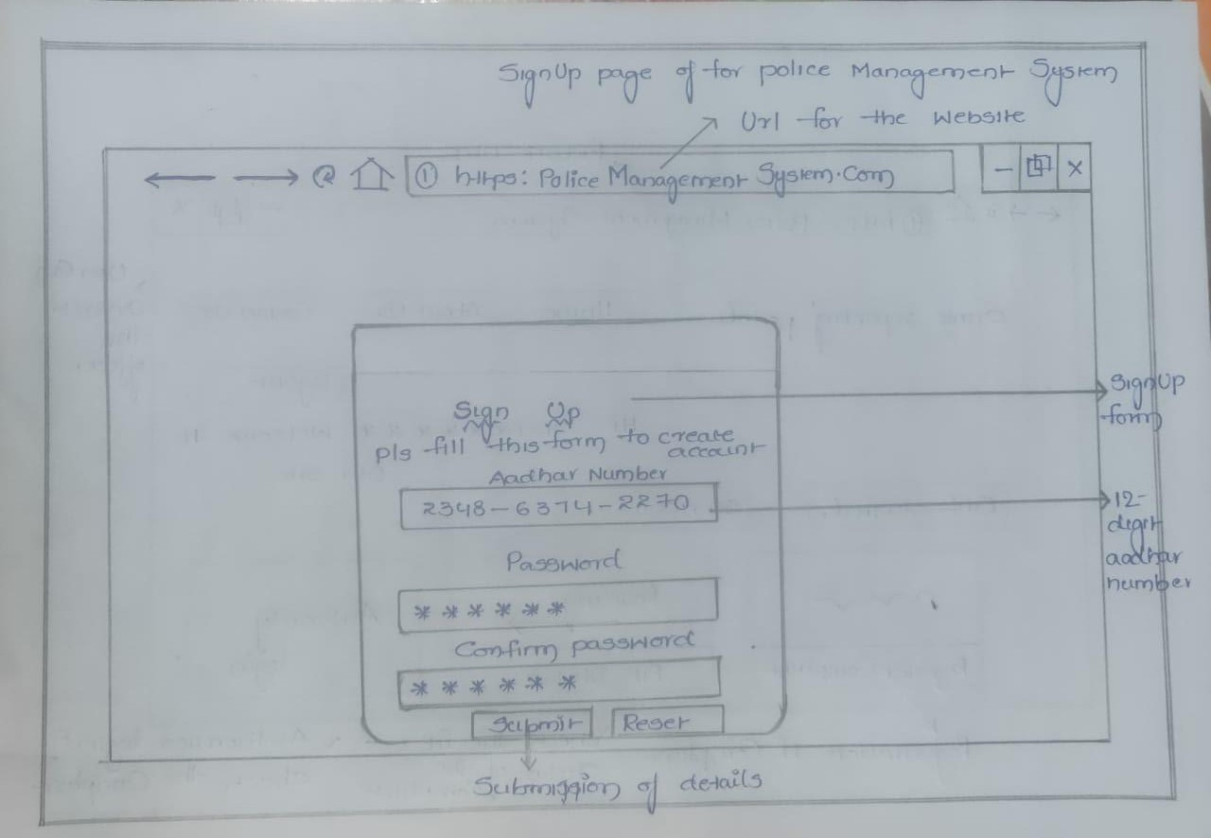

Slide 18
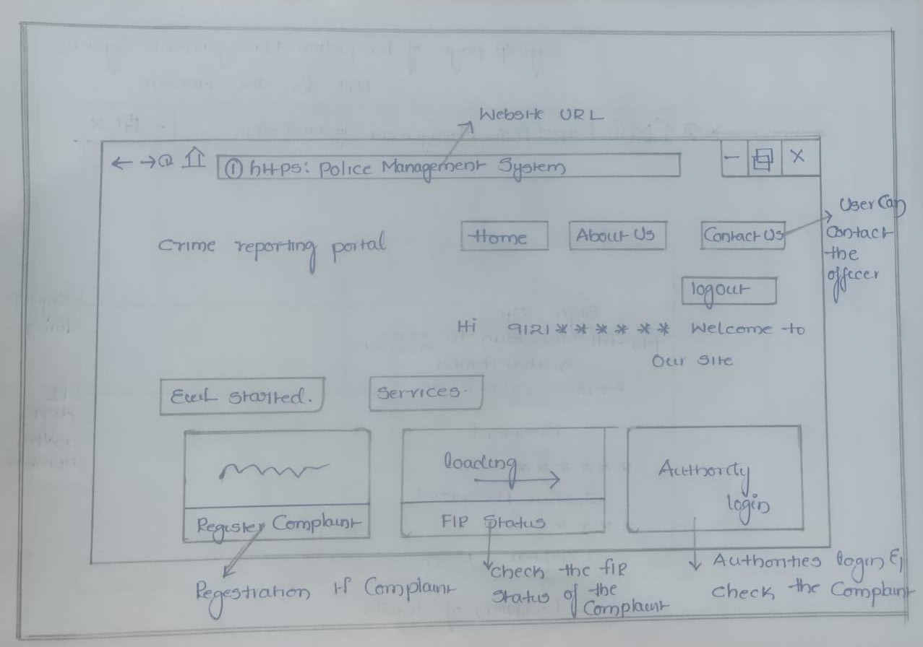

Slide 19
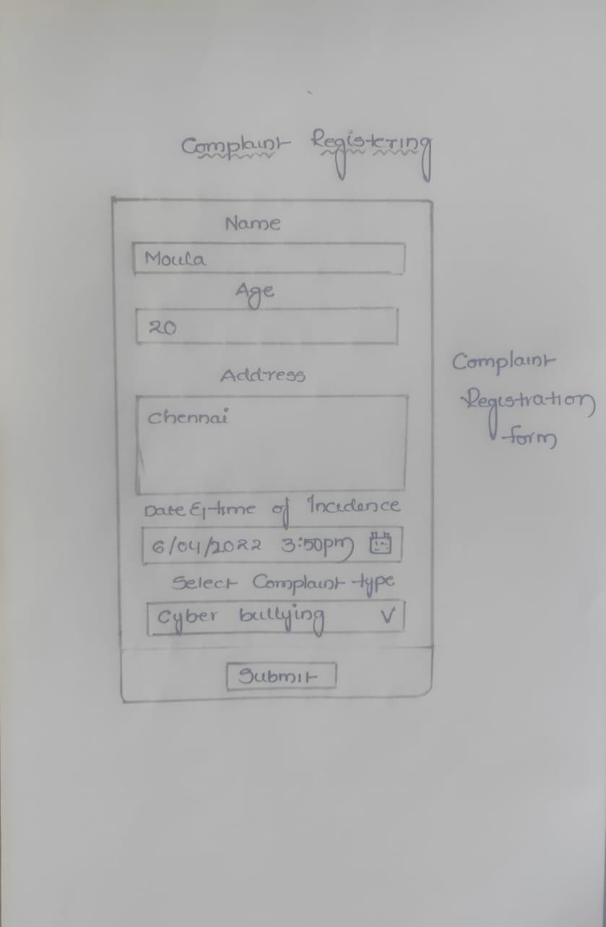

Slide 20
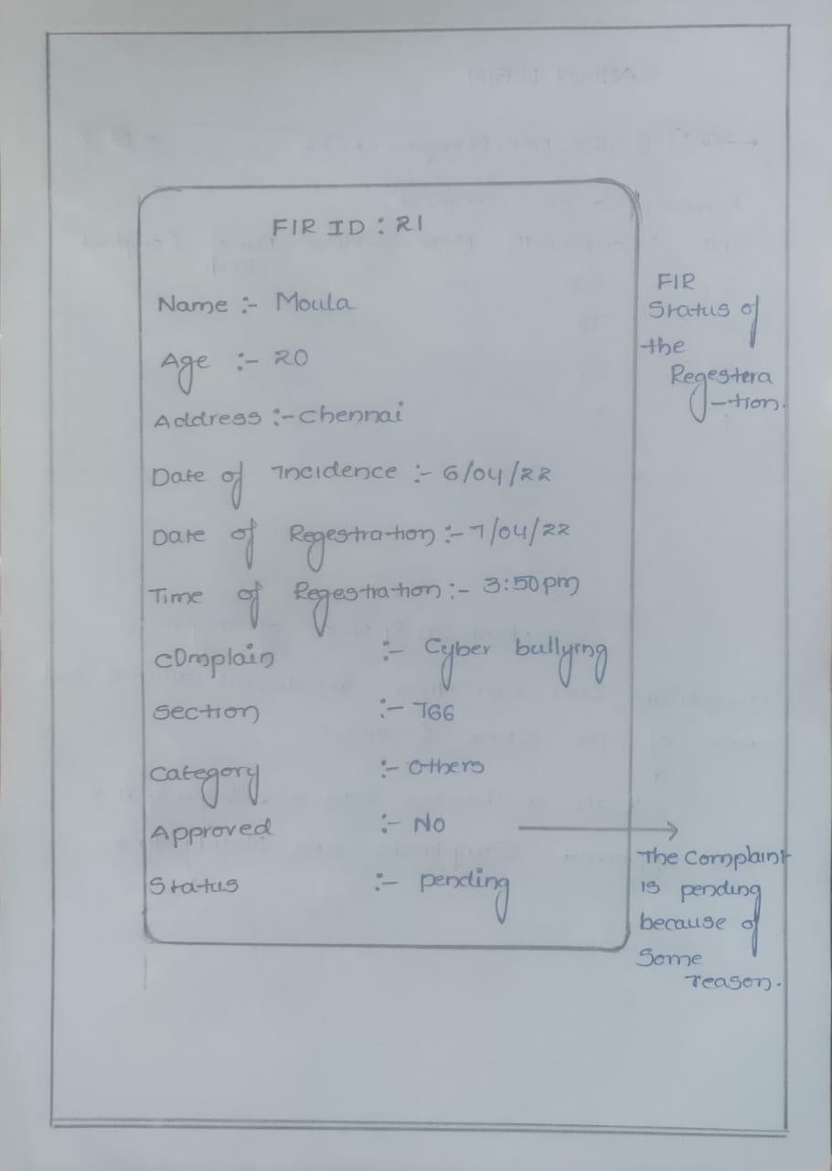

Slide 21
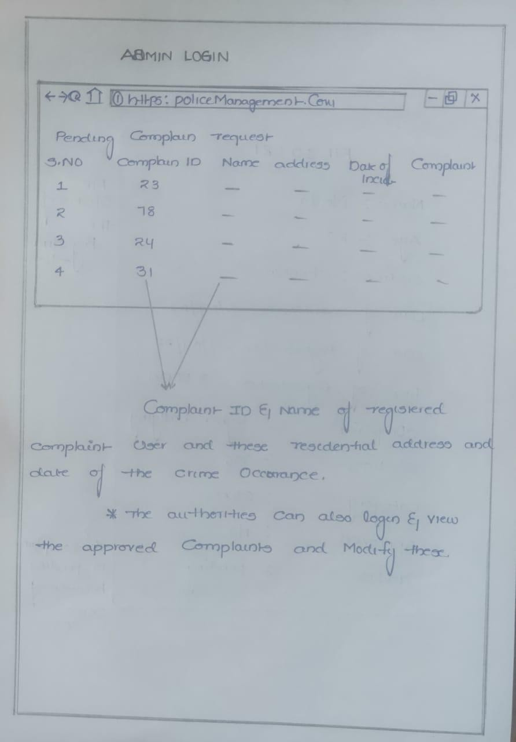

Slide 22
THANK YOU

